Slide 1







Singing with Tiny bit
Play Merry Christma with lights
亚博智能

Slide 2









Contents
Preparation
Learning goal
Search for blocks
Combine blocks
Experimental phenomena
Yahboom

Slide 3

Preparation
1.The position of the buzzer on the robot car
2.Learn some basic music knowledge
Programming method:
Mode 1 online programming: First, we need to connect the micro:bit to the computer by USB cable. The computer will pop up a USB flash drive and click on the URL in the USB flash drive: http://microbit.org/ to enter the programming interface. Add the Yahboom package: https://github.com/YahboomTechnology/Tiny-bitLib to program.
Mode 2 offline programming: We need to open the offline programming software. After the installation is complete, enter the programming interface, click【New Project】, add Yahboom package: https://github.com/YahboomTechnology/Tiny-bitLib, you can program.
Yahboom

Slide 4
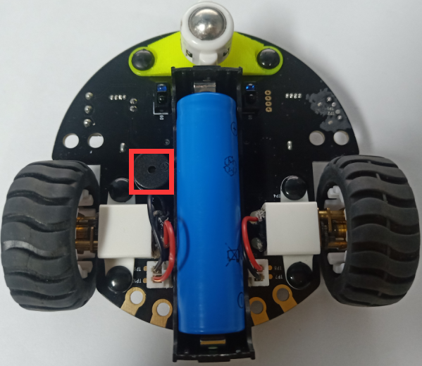
Preparation
In the picture shown below, the black cylinder circled by the red wire frame is the buzzer on the Tiny-bit.
Yahboom

Slide 5
Learning goal
1.Learn how to use buzzer graphically program building blocks
2.In this lesson, we will play music 《Merry Christmas》with colorful lights.
Yahboom

Slide 6

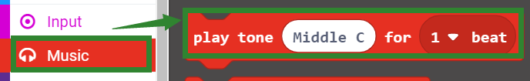
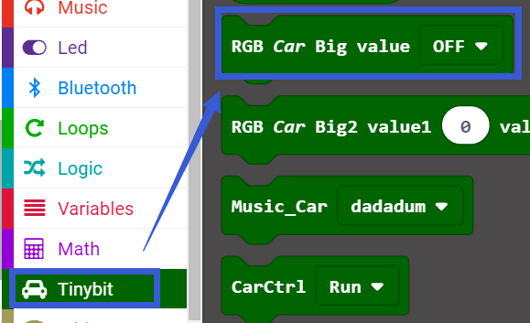
Search for block
The following is the location of the building blocks required for this programming.
Yahboom

Slide 7
Combine block
Please refer to the hex file for this course summary procedure.
Yahboom

Slide 8
Experimental phenomena
After the program is downloaded, robot car will play 《Merry Christmas》with lights
Yahboom

Slide 9
Inspire Creativity Embrace Innovation
Thank you!!!

